Slide 1
Process of Recombinant DNA Technology
GROUP 6

Slide 2
Process of Recombinant DNA Technology
Recombinant DNA Technology
It involves the selection of the desired gene for administration into the host followed by a selection of the perfect vector with which the gene has to be integrated and hence the recombinant DNA is formed.
GROUP 6

Slide 3
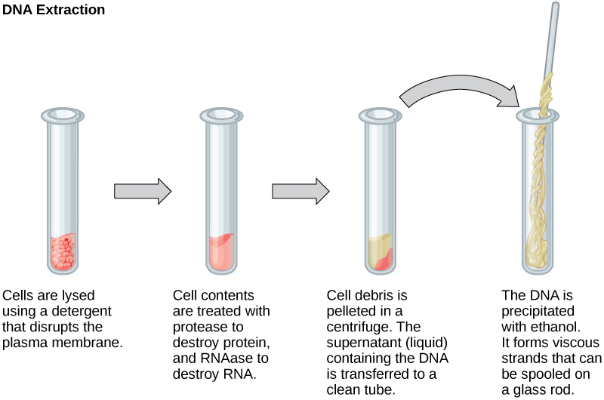
Process of Recombinant DNA Technology
PROCESSES
1. Isolation of DNA
Isolation of DNA is an enzymatically controlled process where the plant or animal cells are treated with certain enzymes.
GROUP 6

Slide 4
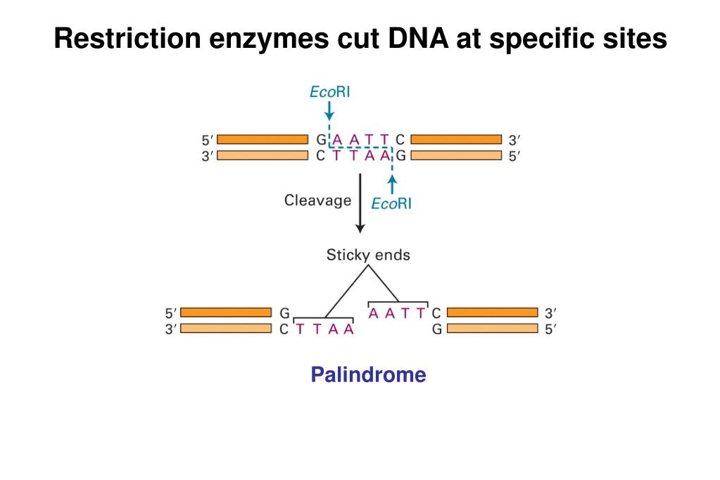
2. Cutting the Genes
The restriction enzymes cut the DNA into blunt end and cohesive end depending upon the mixture of these DNA fragments is electrophoresed on an agarose gel for a particular time.

Slide 5
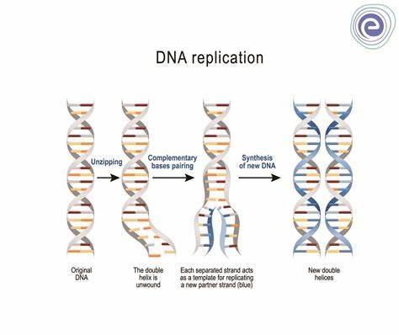
3. Joining DNA
-Joining of DNA is termed as Ligation.
-Process of joining two pieces, a cut fragment of DNA and the vector together with the help of the enzyme DNA ligase.

Slide 6
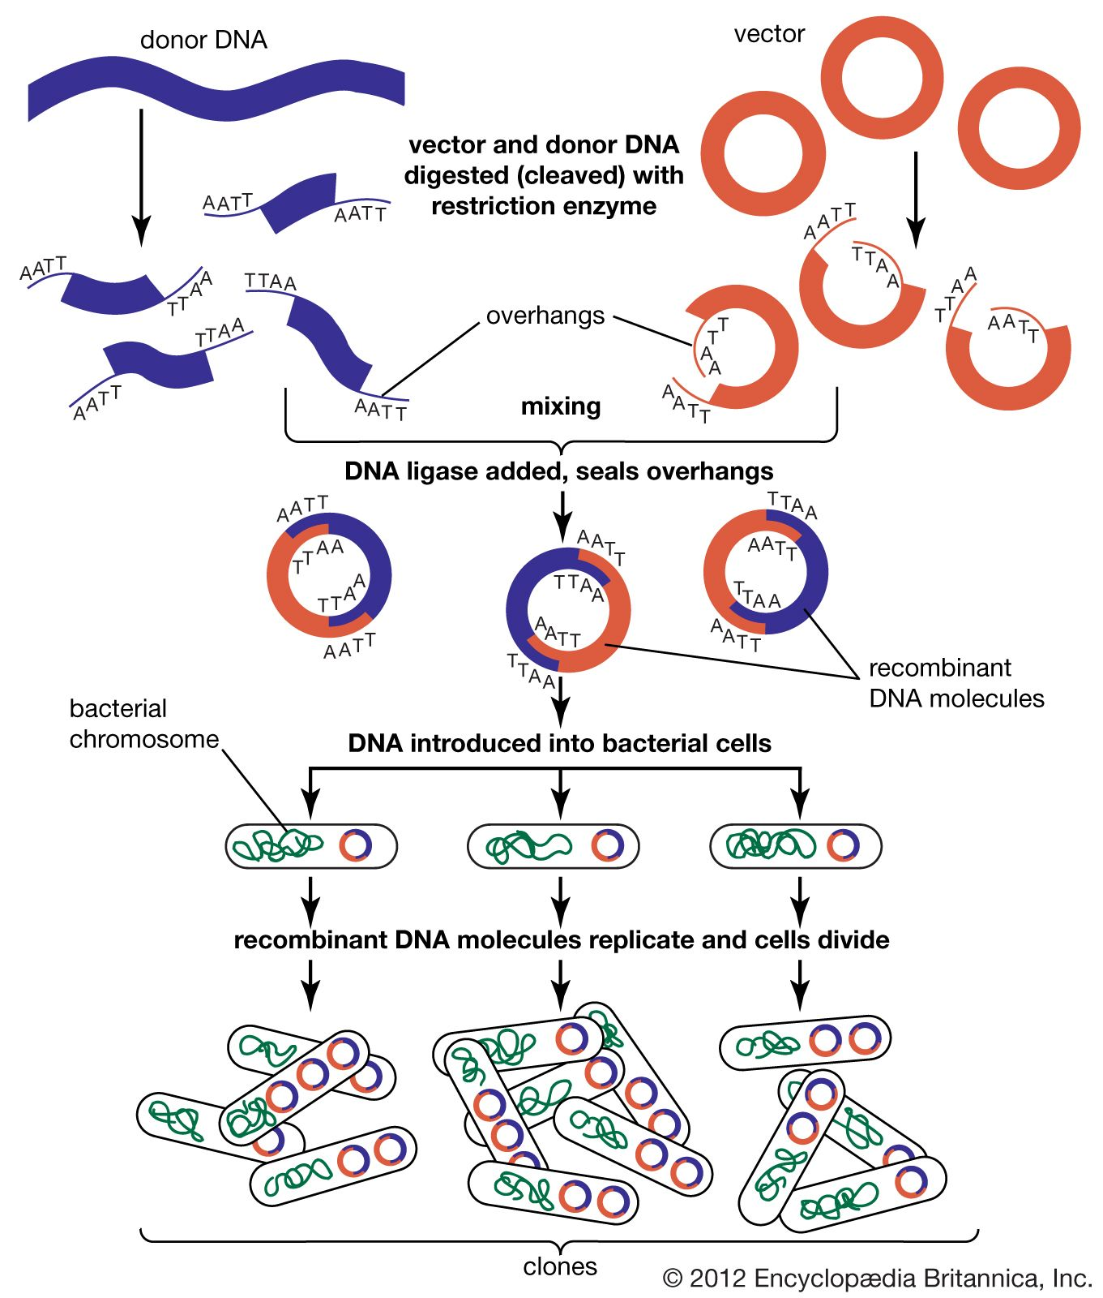
4. Amplification of DNA
- use DNA polymerase enzymes to copy the identified gene sequence through the polymerase chain reaction (PCR).
- multiple copies of the desired DNA fragment are synthesized in vitro by the following three steps; denaturation, annealing of primers and primer extension or synthesis.

Slide 7
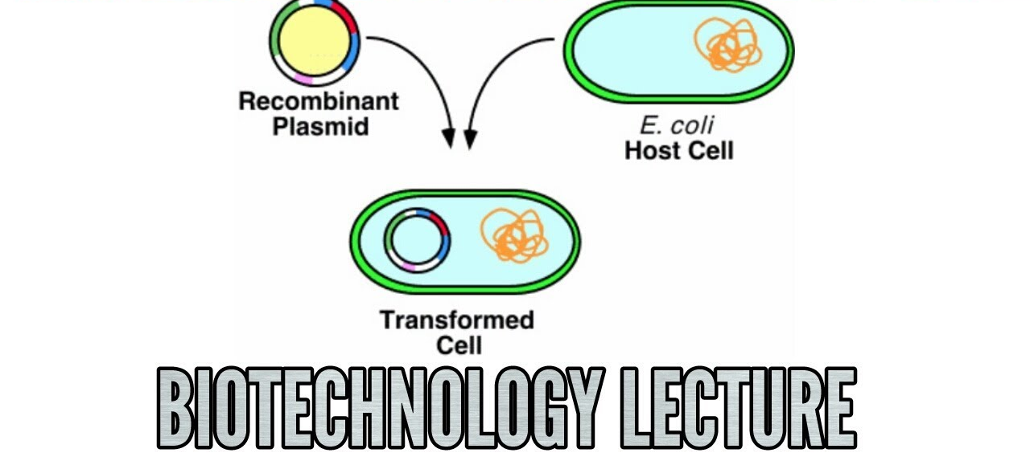
5. Transfer of recombinant DNA to host cells
-process is known as Transformation, where specifically recombinant DNA is entered into a recipient cell of the host
- involves the transfer of recombinant DNA such as the indirect method which uses vectors or carriers. Direct methods like electroporation and microinjection

